Slide 1
Category review: Chips
June 2020
Retail Analytics
Brand note: If client logo is not required, use alternate title page layout right click slide thumbnail > Layout > Title

Slide 2
Notes:
To view Privacy video explaining how important data privacy is to Quantium, please click here: https://www.youtube.com/watch?v=Zq1QDAkoRzU
or here Q:\Company Reference\Brand & Design\Brand videos\Q Privacy.mp4
At Quantium, we believe that data is the behavioural footprint of humanity and that it has to be treated with the utmost care and responsibility.
Histories, attitudes, indeed lives are stored within it in ways that aren’t always apparent – and that’s what makes its potential so powerful.
To work with it responsibly, sensitively, we set ourselves the highest data privacy protection and governance standards.
We have spent 17 years perfecting privacy-by-design and secure-by-design principles. Central to this is not holding any personally identifiable information about people –
we neither receive it, and put the necessary protections in place to be unable to decipher it.
Every aspect of handling data is safeguarded: from its de-identification, to its encryption – data security is paramount and of the highest grade.
We pride ourselves on gaining the trust of iconic organisations around the world through years of securely working with their data,
and in turn the trust that builds with their stakeholders.

Slide 3
Executive summary
01
02
Task 2
Task 1
We can see that Trial store 77 sales for Feb, March, and April exceeds 95% threshold of control store. Same goes to store 86 sales for all 3 trial months.
Trial store 77: Control store 233
Trial store 86: Control store 155
Trial store 88: Control store 40
Both trial store 77 and 86 showed significant increase in Total Sales and Number of Customers during trial period. But not for trial store 88. Perhaps the client knows if there's anything about trial 88 that differs it from the other two trial.
Overall the trial showed positive significant result.
Top 3 total sales contributor segment are
Older families (Budget) $156,864
Young Singles/Couples (Mainstream) $147,582
Retirees (Mainstream) $145,169
Young Singles/Couples (Mainstream) has the highest population, followed by Retirees (Mainstream). Which explains their high total sales.
Despite Older Families not having the highest population, they have the highest frequency of purchase, which contributes to their high total sales.
Most frequent chip size purchased is 175gr followed by the 150gr chip size for all segments.

Slide 4
01
Category

Slide 5
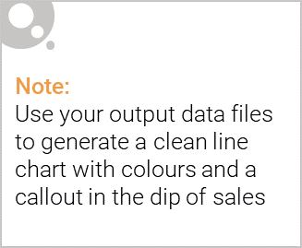
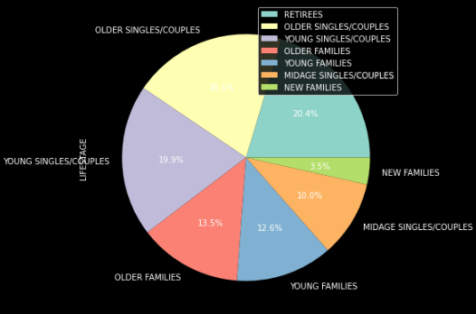
Overview:

Slide 6

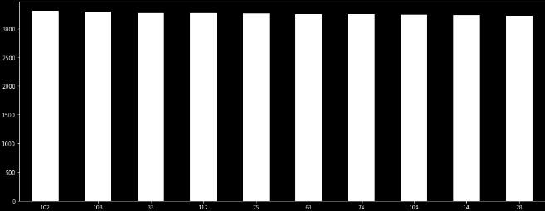
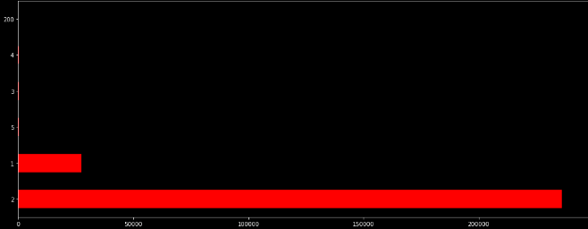
Customer Product Relationship :
Most Purchased Product number : 102
Most products purchased in Pack of 2

Slide 7
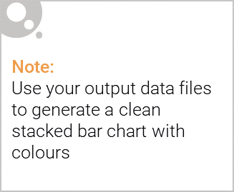
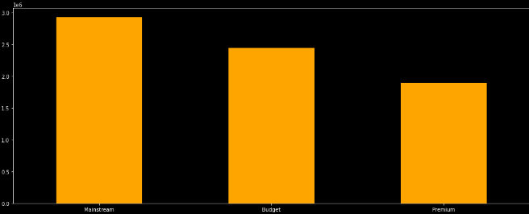
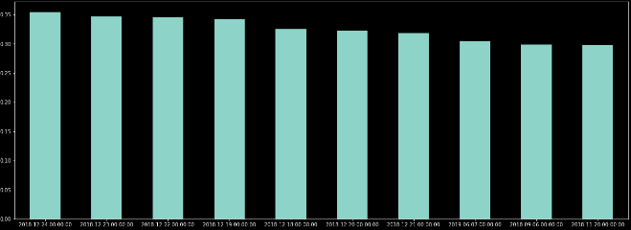
Editable (delete this)
Customer Purchase Behaviour :
The customers having loyalty card are most mainstream customers > Budget > Premium
We can clearly see that the most of the transactions are around Christmas!

Slide 8
02
Trial store performance

Slide 9
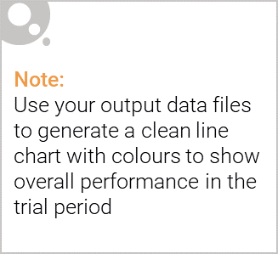
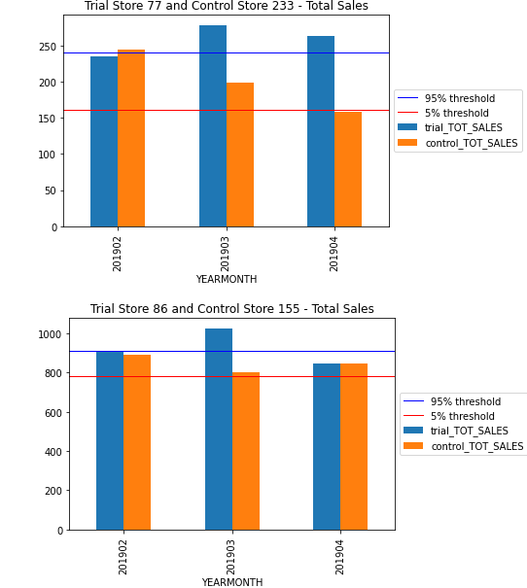
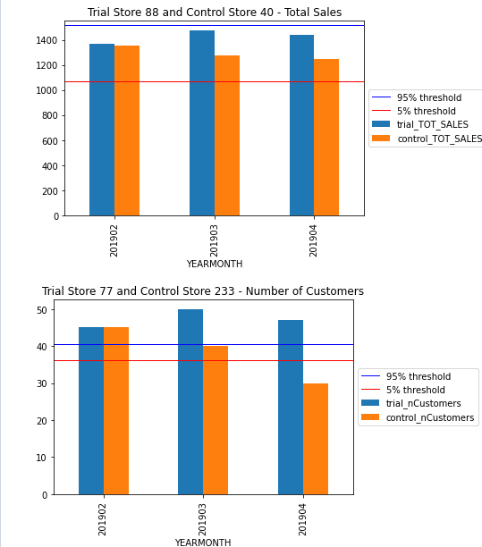
Explanation of the control store vs other stores :

Slide 10
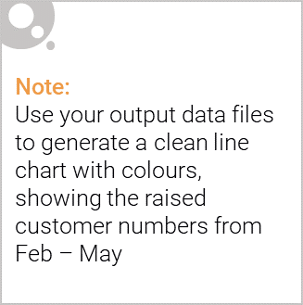
Summary :
We can see that Trial store 77 sales for Feb, March, and April exceeds 95% threshold of control store. Same goes to store 86 sales for all 3 trial months.
Trial store 77: Control store 233
Trial store 86: Control store 155
Trial store 88: Control store 40
Both trial store 77 and 86 showed significant increase in Total Sales and Number of Customers during trial period. But not for trial store 88. Perhaps the client knows if there's anything about trial 88 that differs it from the other two trial.
Overall the trial showed positive significant result.

Slide 11
Thank You

